Slide 1
A Parallel quicksort algorithm using NVIDIA GPU.
Anish Kumar Jha
Vivek Kumar Thakur
Rahul Jaswal
Notes:
1

Slide 2
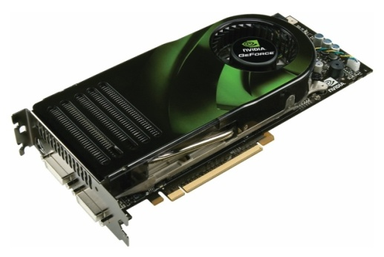
Overview
System Model
The Algorithm
5 8 3 2
3 2
5 8
2
3
5
8

Slide 3
System Model
System Model

Slide 4
CPU vs. GPU
Multi-core
Large cache
Few threads
Speculative execution
Many-core
Small cache
Wide and fast memory bus
Thousands of threads hides memory latency
Normal processors
Graphics processors
Notes:
4

Slide 5

CUDA
Designed for general purpose computation
Extensions to C/C++

Slide 6
System Model – Global Memory
Global Memory

Slide 7
System Model – Shared Memory
Global Memory
Multiprocessor 0
Multiprocessor 1
Shared
Memory
Shared
Memory

Slide 8
System Model – Thread Blocks
Global Memory
Multiprocessor 0
Multiprocessor 1
Thread Block 0
Thread Block 1
Thread Block x
Thread Block y
Shared
Memory
Shared
Memory

Slide 9
Challenges
Minimal, manual cache
32-word SIMD instruction
Coalesced memory access
No block synchronization
Expensive synchronization primitives
Notes:
9

Slide 10
The Algorithm
System Model
The Algorithm
5 8 3 2
3 2
5 8
2
3
5
8

Slide 11
Quicksort
5 8 3 2
3 2
5 8
2
3
5
8
Notes:
11

Slide 12
Quicksort
5 8 3 2
NOT
Data Parallel!
3 2
5 8
2
3
5
8
Notes:
12

Slide 13
Quicksort
Phase One
Sequences divided
Block synchronization on the CPU
5 8 3 2
3 2
5 8
2
3
5
8
Thread Block 1
Thread Block 2
Notes:
13

Slide 14
Quicksort
5 8 3 2
Phase Two
Each block is assigned own sequence
Run entirely on GPU
3 2
5 8
2
3
5
8
Thread Block 1
Thread Block 2
Notes:
14

Slide 15
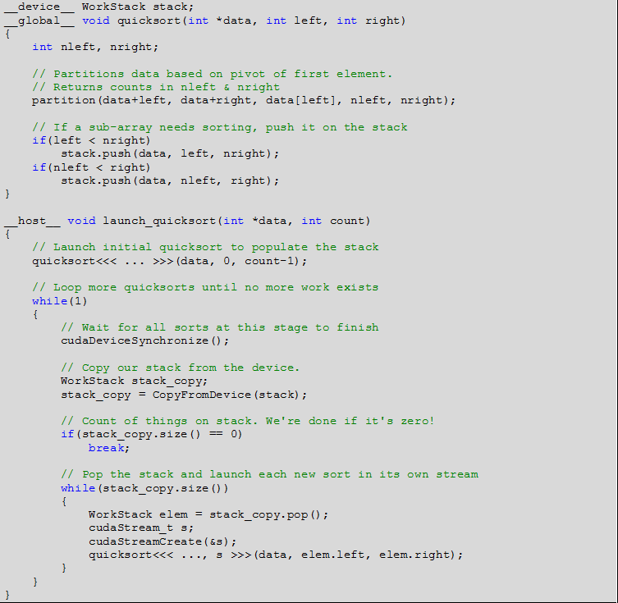
PSEUDO CODE

